Slide 1

Department of Information Engineering & Mathematics
Management Engineering
Business Intelligence Project Presentation
Bahadir Kuzu
128974

Slide 2
ANALYZING THE IMPACT OF FACTORS ON HOUSING PRICES IN LONDON
Abstract:
- Purpose: To analyze the impact of various factors on housing prices in London using the "London Housing Price" dataset from Kaggle.
- Methods: Descriptive statistics, frequency analysis, data visualization, and inferential statistics will be employed.
Hypotheses:
1) The presence of certain features significantly affects house prices.
2) Housing prices differ based on the number of bedrooms.
3) There is a positive relationship between housing prices and square footage.
- Insights: The findings will provide valuable insights into the factors influencing London's housing market.
Introduction:
- Importance: Understanding factors affecting housing prices is crucial for homeowners, agents, and investors in London's dynamic housing market.
- Dataset: "London Housing Price" dataset from Kaggle will be analyzed.
- Approach: Descriptive statistics, frequency analysis, and inferential statistics will be utilized to explore the impact of factors on housing prices.
Methodology
1. Dataset Selection: Utilizing the "London Housing Price" dataset from Kaggle as the primary data source.
2. Descriptive Statistics: Summarizing and analyzing the dataset to identify trends and patterns.
3. Frequency Analysis: Examining the distribution of categorical variables.
4. Data Visualization: Utilizing pie charts and histograms to present the results of the frequency analysis.
5. Inferential Statistics: Testing formulated hypotheses through multiple regression analysis, one-way ANOVA, and bivariate analysis.
6. Statistical Analysis: Determining the statistical significance of hypotheses using appropriate tests and significance levels.

Slide 3
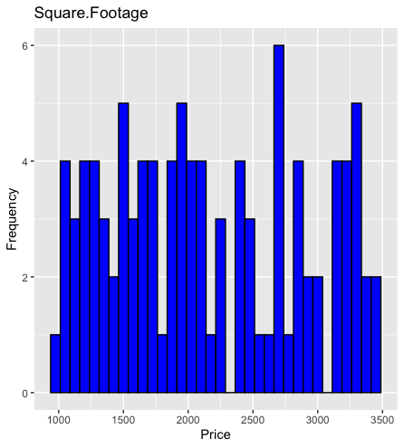
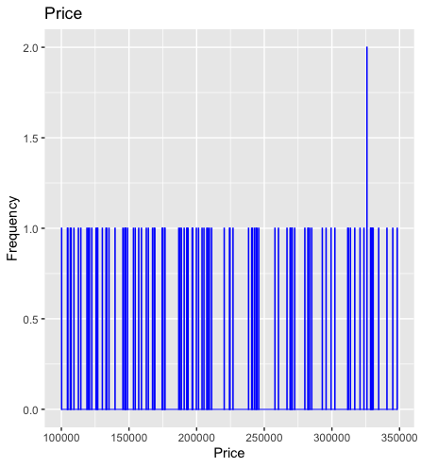
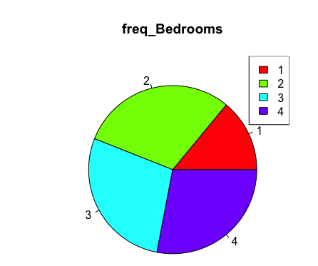
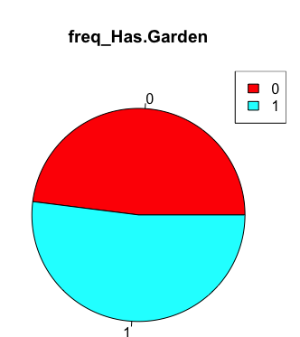
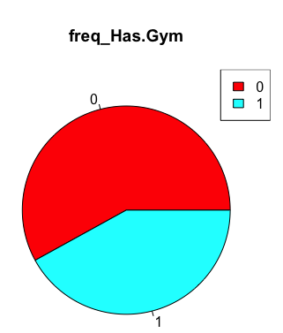
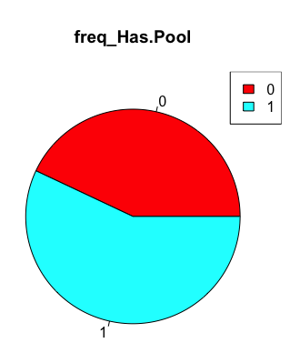
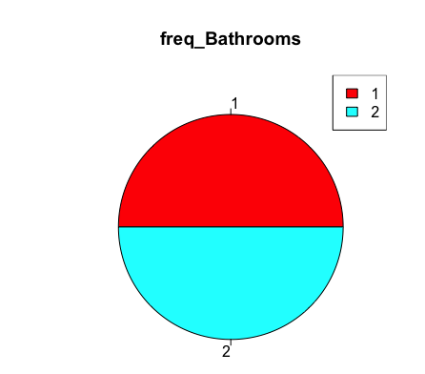
DESCRIPTIVE STATISTICS – LONDON HOUSE PRICES
Square. Footage:
Minimum: 1001
Maximum: 3482
Median: 2046
25th Percentile: 1521
75th Percentile: 2804
Price:
Minimum: 100,225
Maximum: 348,350
Median: 204,725
25th Percentile: 152,238
75th Percentile: 280,550
Bedrooms:
1 bedroom: 14 houses
2 bedrooms: 30 houses
3 bedrooms: 28 houses
4 bedrooms: 28 houses
Bathrooms:
1 bathroom: 50 houses
2 bathrooms: 50 houses
Has. Garden:
Houses without a garden: 48 houses
Houses with garden: 52 houses
Has. Pool:
Houses without pool: 43%
Houses with pool: 57%
Has. Gym:
Houses without a gym: 58 houses (58%)
Houses with gym: 42 houses (42%)

Slide 4
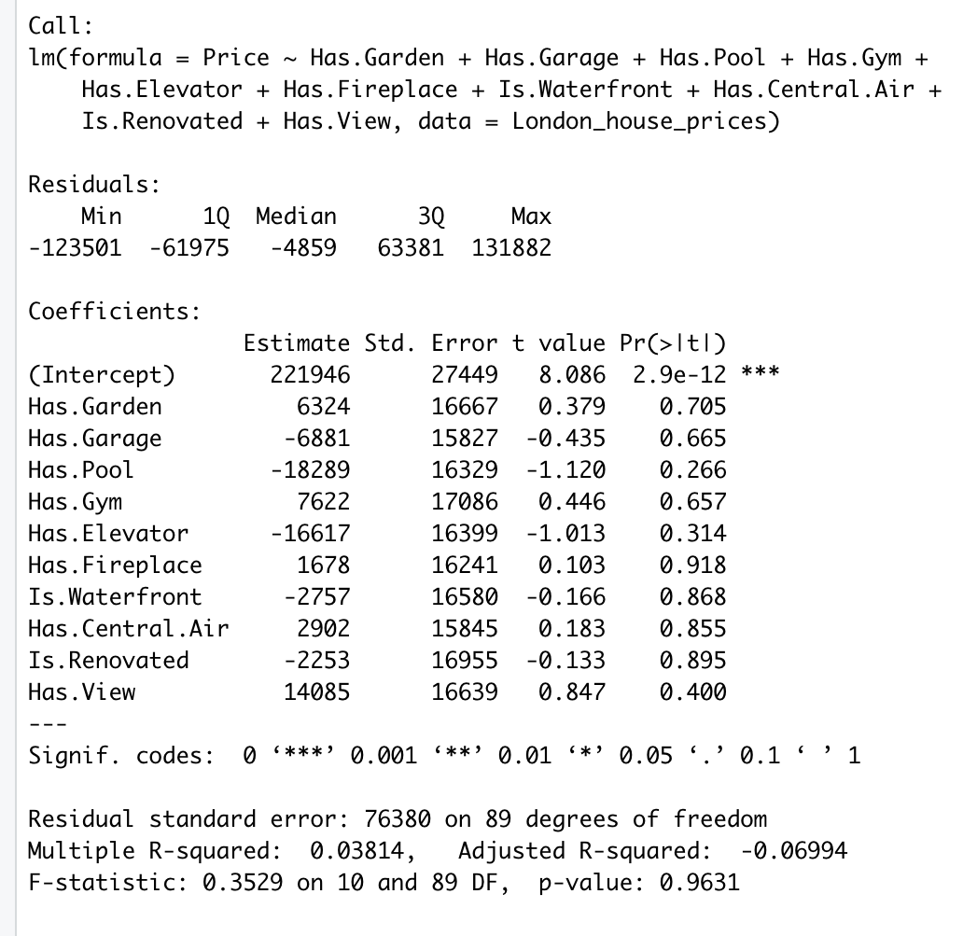
REGRESSION MODEL ANALYSIS
Hypothesis:
Having a garden, garage, pool, gym, elevator, fireplace, waterfront, central air, renovated status, and having a natural view have a significant impact on London house prices.
Regression Results:
Coefficients: The estimated effects of independent variables on London house prices.
None of the independent variables show statistically significant effects.
P-values: All coefficients are greater than 0.05, indicating no significant impact.
Adjusted R-squared: -0.06994, suggesting a small proportion of variance explained.
Conclusion: No evidence to support the hypothesis.

Slide 5
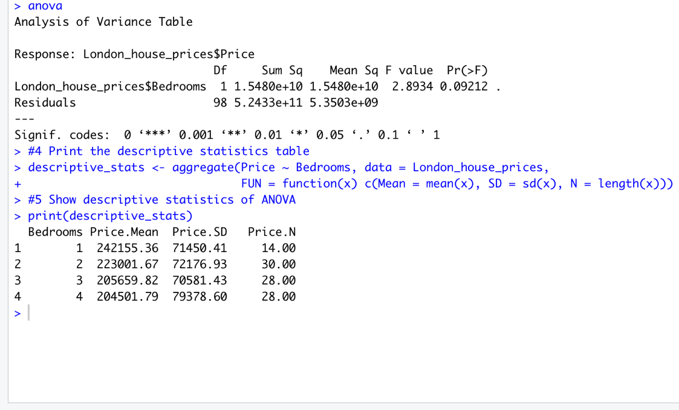
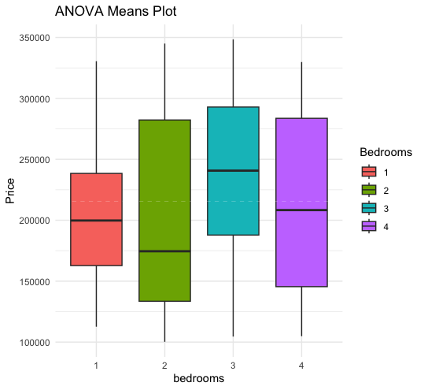
ANOVA AND CORRELATION ANALYSIS
Anova:
Hypothesis: London housing price differs based on the number of bedrooms.
One-way ANOVA results: No statistically significant difference was observed.
F-statistic: 2.8934, p-value: 0.09212.
Descriptive statistics: Mean prices for different bedrooms are similar.
Conclusion: The number of bedrooms may have some influence, but not the sole determinant.
Correlation:
Hypothesis: London housing price has a positive relationship with square footage.
Correlation coefficient: 0.9999997, indicating a strong positive relationship.
The high correlation suggests increasing prices with increasing square footage.
P-value: Essentially zero, indicating a statistically significant correlation.
Conclusion: Statistically significant and positive relationship between square footage and prices.

Slide 6
CONCLUSION AND RECOMMENDATION
Conclusion:
- Independent variables (e.g., garden, garage, pool, gym, elevator, fireplace, waterfront, central air, renovated status, natural view) do not significantly impact London house prices.
- Model with these variables explains a small proportion of price variance.
- Additional investigation and consideration of other variables are necessary to better understand factors influencing London house prices.
- Number of bedrooms may have some influence, but not the sole determinant.
- One-way ANOVA results show no statistically significant difference, but F-statistic and descriptive statistics provide some evidence of a difference.
- Other factors beyond bedrooms may contribute to observed price differences.
- Square footage has an extremely high correlation coefficient with price, indicating a strong positive relationship.
- P-value associated with correlation coefficient is essentially zero, providing strong evidence against the null hypothesis of no correlation.
- Statistically significant and positive relationship between square footage and house prices in London.
Recommendation:
- Consider other factors beyond the ones analyzed in this study to gain a comprehensive understanding of determinants of London house prices.
- Future research should explore and incorporate additional variables that may have a significant impact on housing prices in London.
- Enhance accuracy and reliability of predictive models by incorporating these variables.
- Provide a more nuanced understanding of factors driving house prices in the city.

